Slide 1



VIBRATO
MUSIC MANAGEMENT WEBSITE
SPARSH WABHALE

Slide 2
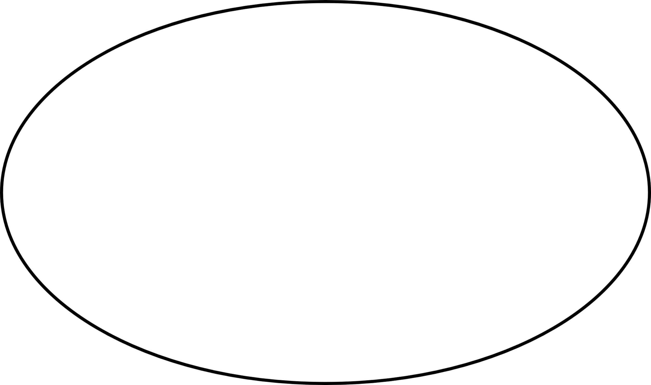

INTRODUCTION
WELCOME TO THE MUSIC MANGEMENT WEBSITE, VIBRATO.
In Vibrato you can find your songs according to your favorite Language, Artist and Genre.
MOBILE NUMBER

Slide 3
ABSTRACT
The aim of this project is the development of a centralized relational Music website.
This website provides users to make accounts and utilize the software to access Music and songs. This will be achieved by implementation of Database management and using a GUI interface for the complete software.
MOBILE NUMBER

Slide 4
PROBLEM/ USE :
1
2
3
New or first time user need to register in this website.
User need to login with proper credential like username and password.
User have the choice to choose songs according to genre, language and artist.
4
After selecting preferences user can view songs of their preferences.

Slide 5
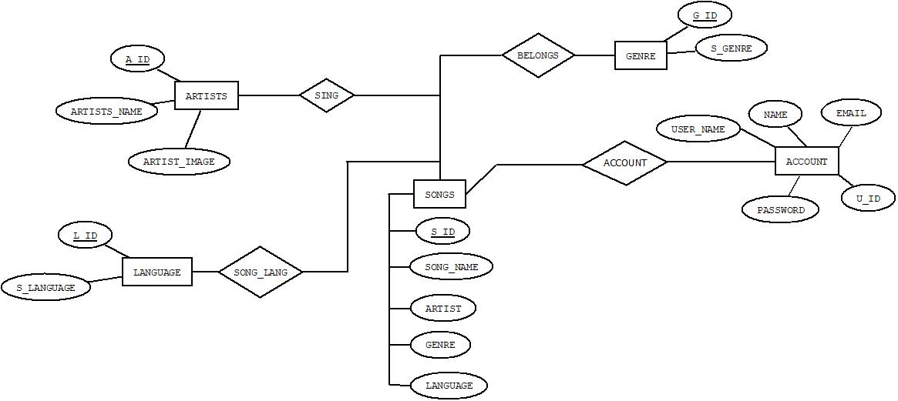


ER DIAGRAM

Slide 6
MODULE DESCRIPTIONS
The whole website has three parts front end , back end and database.
In front end we used HTML for structure and CSS for styling.
In back end we used PHP language.
For connecting the two interface we use XAMPP software.
We have used SQL DATABASE for storing the data.

Slide 7
MAJOR MODULES
USER’S ACOUNT:
➔ REGISTER/SIGN UP: The website allows to create an account/profile. This will help to categorize elements which only a particular user wants to keep or change. It also allows to keep a check on the number of users accessing or using our website.
The account registration stores the following credentials of the user,
➔ LOGIN: The login is created to identify the particular user, who is going to use the website. The login module checks the username and password entered by the user. The entered username and password are checked with the database where the registered information is stored. The data is checked and if it matches, it allows the user into the website. This ensures privacy of the user in the website. Also, it helps to keep a track of the user’s activity in the website.
NAME
User
Email ID
Password

Slide 8
MAJOR MODULES
2) MAIN PAGE: The main page of the website provides options to navigate through all other modules or webpages provided.
The main page consists of the following four buttons,
From the main page the user can navigate to these 4 pages and access the particular song he/she requires. This helps to branch the available options and also makes it easy and efficient for user to see the songs.
Further explaining the sub-modules of the page,
a) SONGS: The song webpage displays all the songs entered in database.
It shows all the data of the song including Song’s name, Artist’s name, Language and Genre of the song.
By connecting the back end to the database, we could display all the information present in database in the website. Through front end coding (using HTML & CSS), the information is displayed on the website in a card.
The font, colour and style set through front end coding makes the website look attractive and organized
a) SONGS
b) ARTISTS
c) LANGUAGE
d) GENRE

Slide 9
MAJOR MODULES
b) ARTISTS: The artists webpage displays all the names of the artists with their images entered in database.
This page helps the user to access songs based on the artists. This categorization helps user to see the songs of their favorite artists.
When the user clicks VIEW button of any particular artist. The songs of the particular artist are displayed on the screen. The working behind this categorization is based on Database constraints used in database.
The particular ID of the artist is passed as a data when we click the view of the corresponding artist. The ID is then matched to the main database of the song where the artist ID corresponding the song present is displayed.
This way the segregation of songs is achieved through commands of mysql.

Slide 10
MAJOR MODULES
c) LANGUAGE: This page displays the languages of songs available in server.
The languages provided for this project are,
Hindi
English
Bengali
Punjabi
Korean
When the user clicks the particular language, corresponding songs of that language is displayed.
This is achieved through the same working principle used in artist by passing ID and mapping it to the song database.

Slide 11
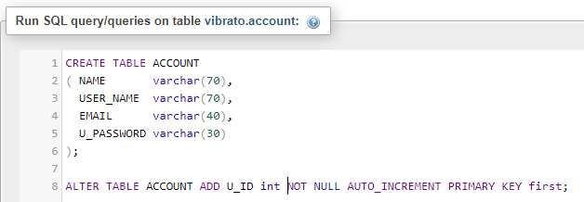
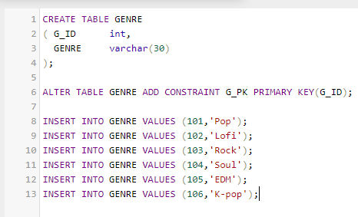
ROLE OF DBMS IN THE PROJECT
SQL QUERY

Slide 12
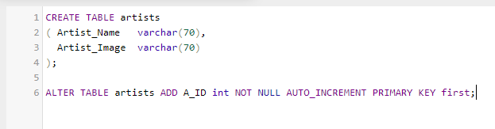
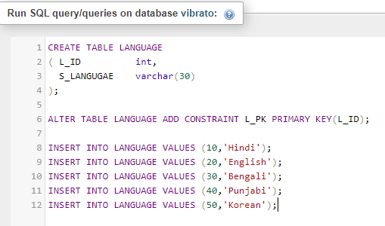
ROLE OF DBMS IN THE PROJECT

Slide 13
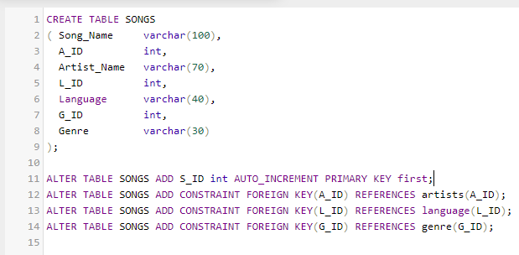
ROLE OF DBMS IN THE PROJECT

Slide 14
ARTIST
A_ID- primary key
LANGUAGE
GENRE
L_ID-primary key
G_ID-primary key
SONG
L_1D,A_ID,G_ID-foreign key

Slide 15
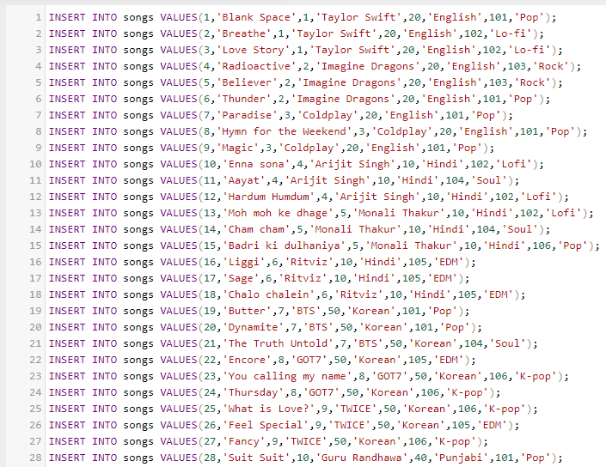
ROLE OF DBMS IN THE PROJECT

Slide 16
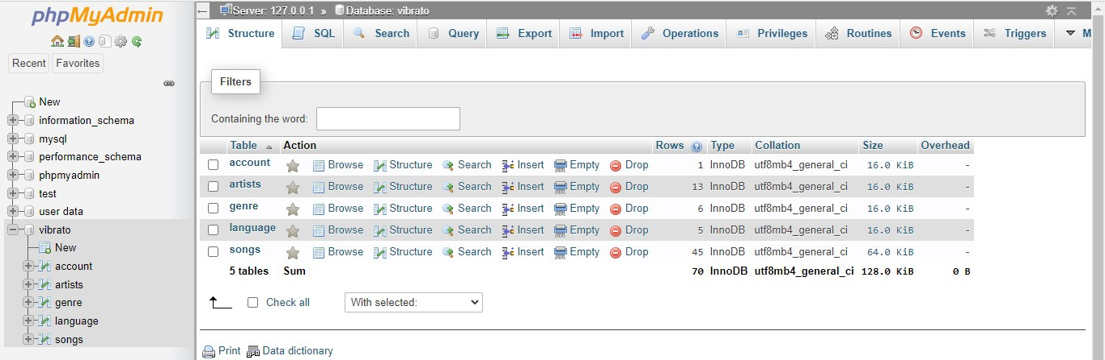
ROLE OF DBMS IN THE PROJECT
DATABASE

Slide 17
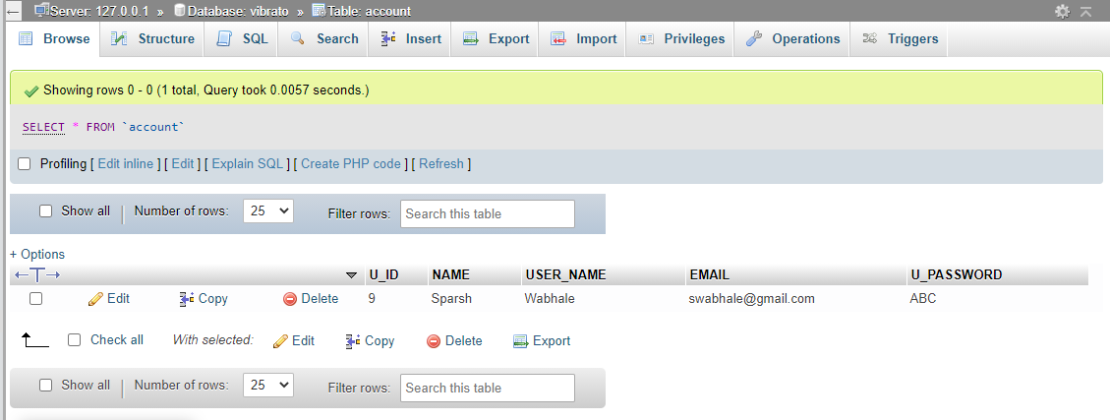
ROLE OF DBMS IN THE PROJECT
TABLES
ACCOUNT

Slide 18
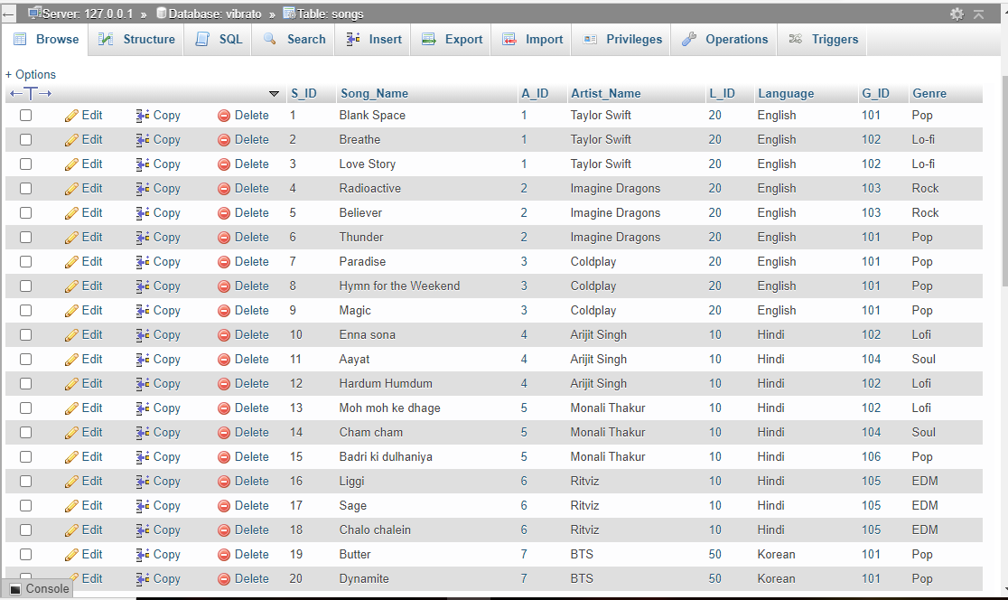
ROLE OF DBMS IN THE PROJECT
2. Songs

Slide 19
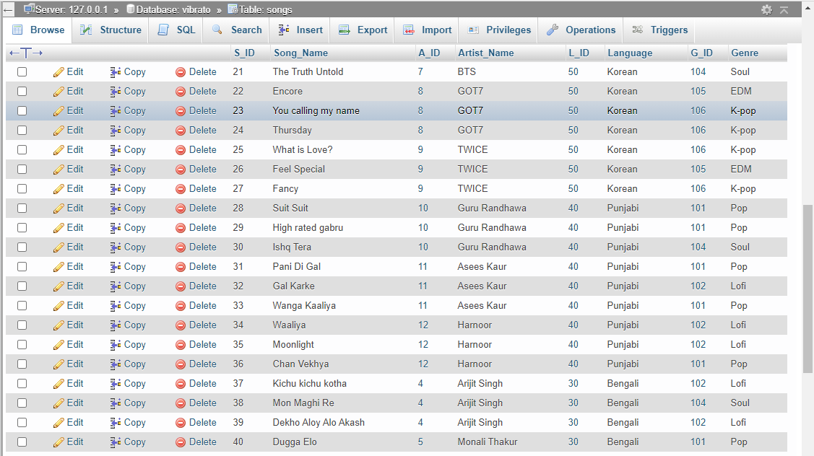
ROLE OF DBMS IN THE PROJECT

Slide 20
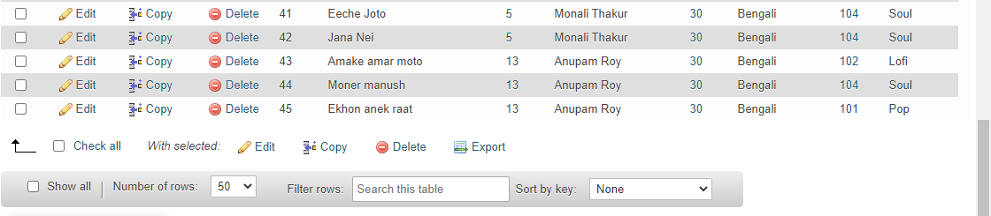
ROLE OF DBMS IN THE PROJECT

Slide 21
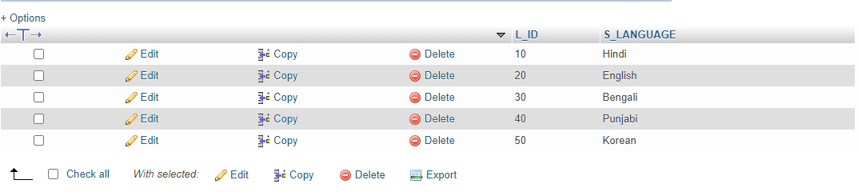
ROLE OF DBMS IN THE PROJECT
3. Language

Slide 22
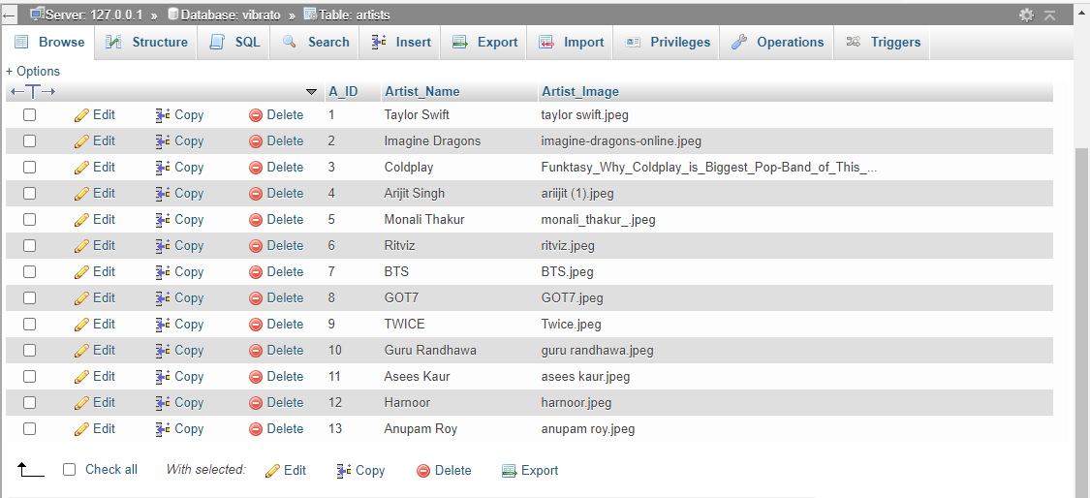
ROLE OF DBMS IN THE PROJECT
3. Artist

Slide 23
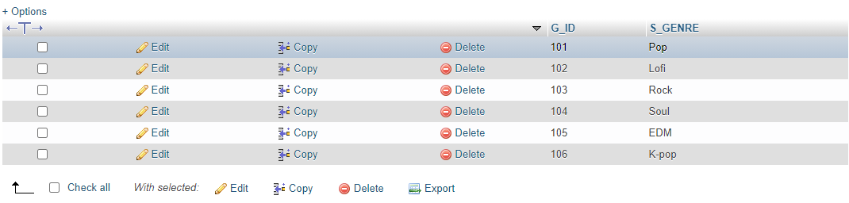
ROLE OF DBMS IN THE PROJECT
4. Genre

Slide 24
IMPLEMENTATION OF THE PROJECT
The main purpose of the project is to help user find preferred songs based on artists, language or genre.
Further it helps the user to know all the information and data of the song (i.e.) Song name, Artist name, Language and Genre.
The same model can be also used for various other purposes which will help users to understand data.
Presenting/displaying the data in an attractive and efficient manner allows the user to interpret and access the data easily, efficiently and quickly

Slide 25
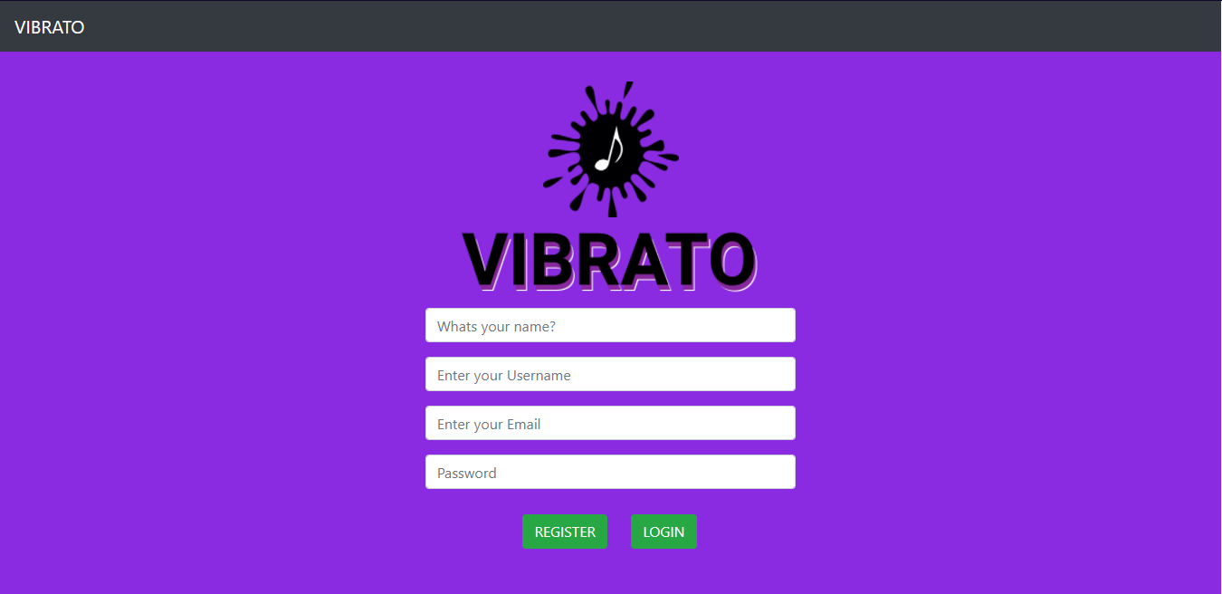

REGISTER PAGE

Slide 26
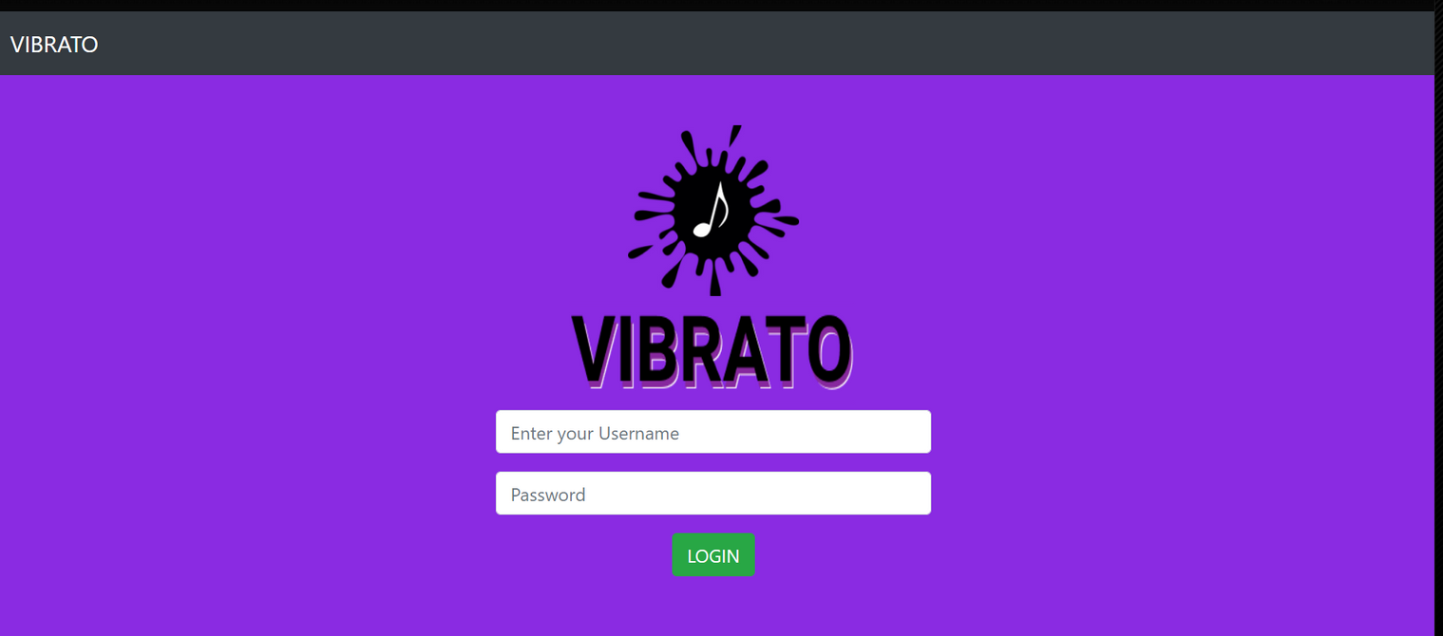
LOG-IN PAGE

Slide 27
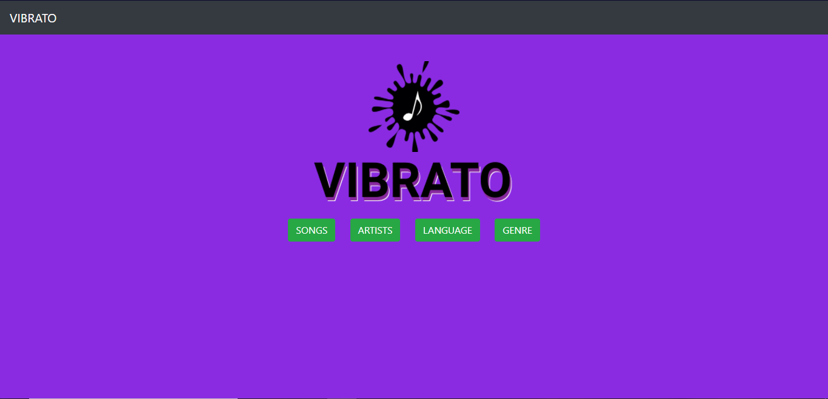
HOME PAGE

Slide 28
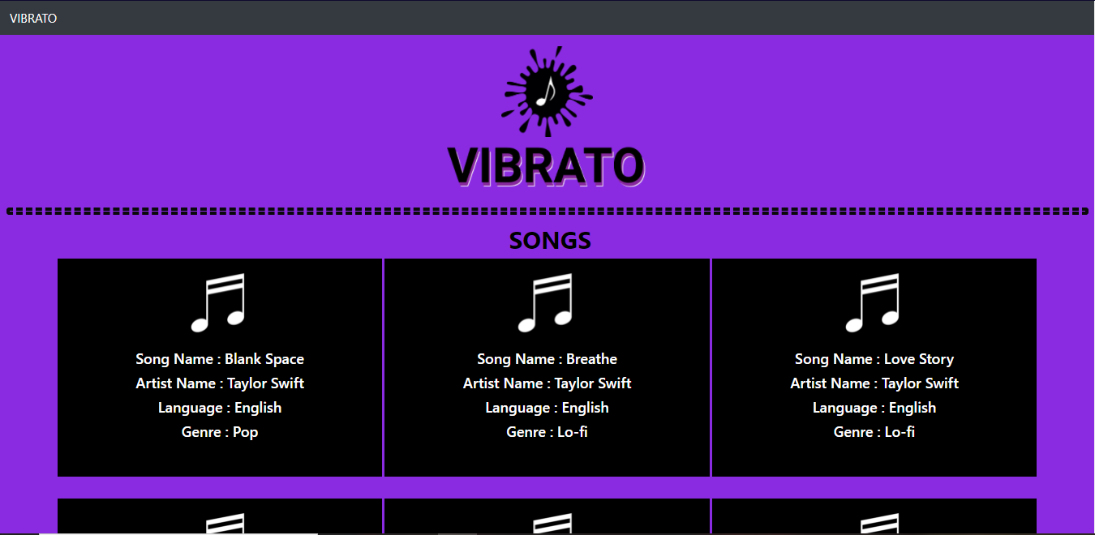
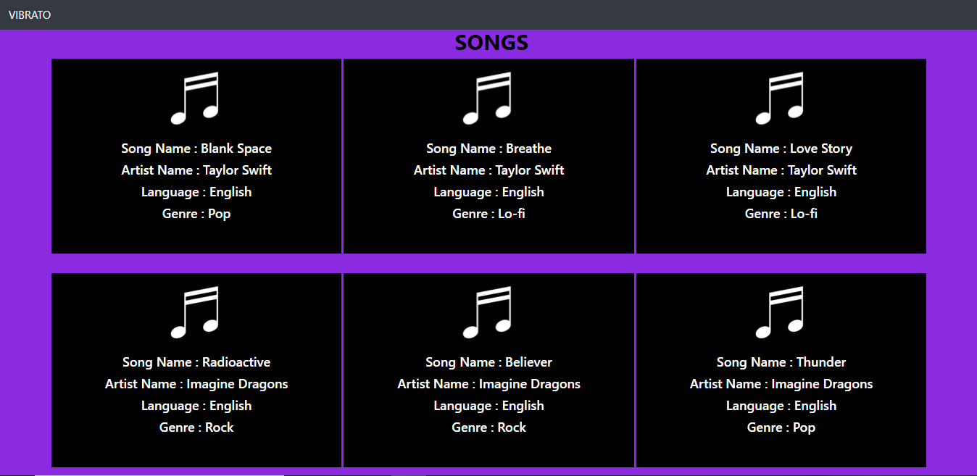
SONG PAGE

Slide 29
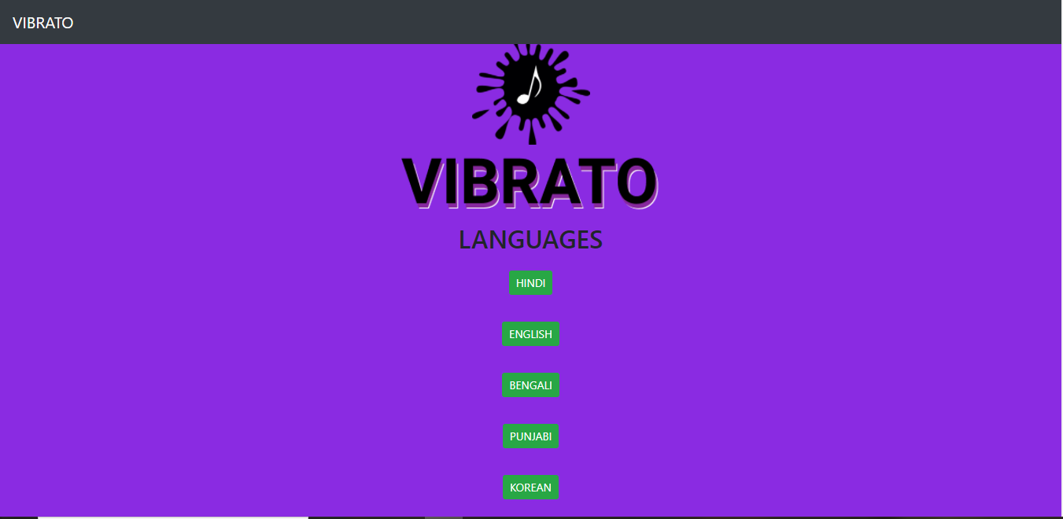
LANGUAGE PAGE

Slide 30
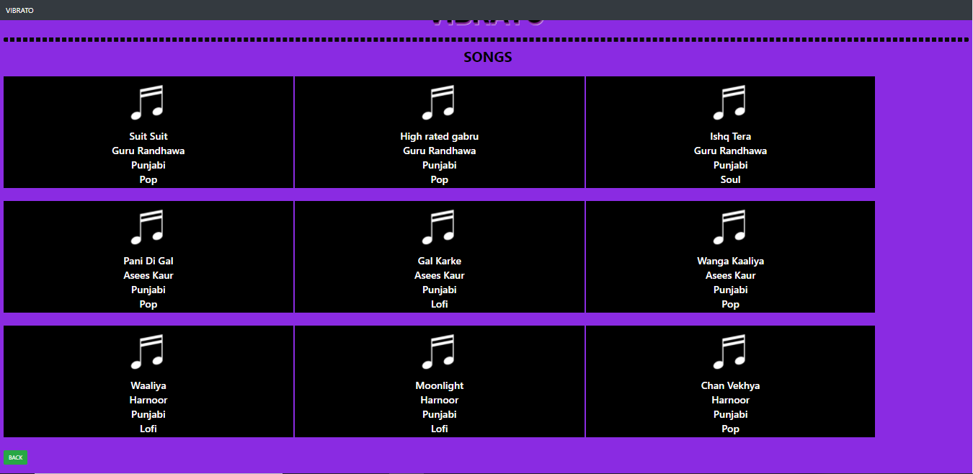
PAGE INSIDE LANGUAGE (ANY LANGUAGE BUTTON)

Slide 31
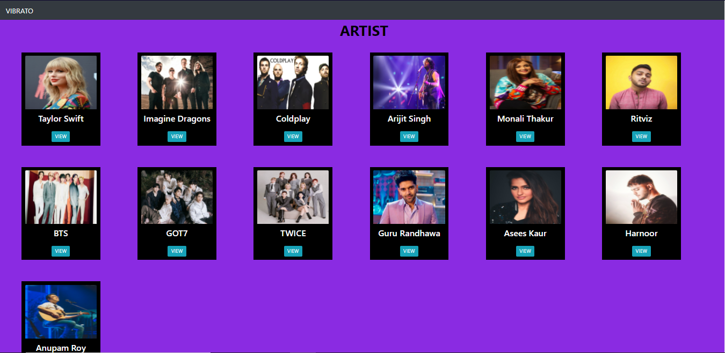
ARTIST PAGE

Slide 32
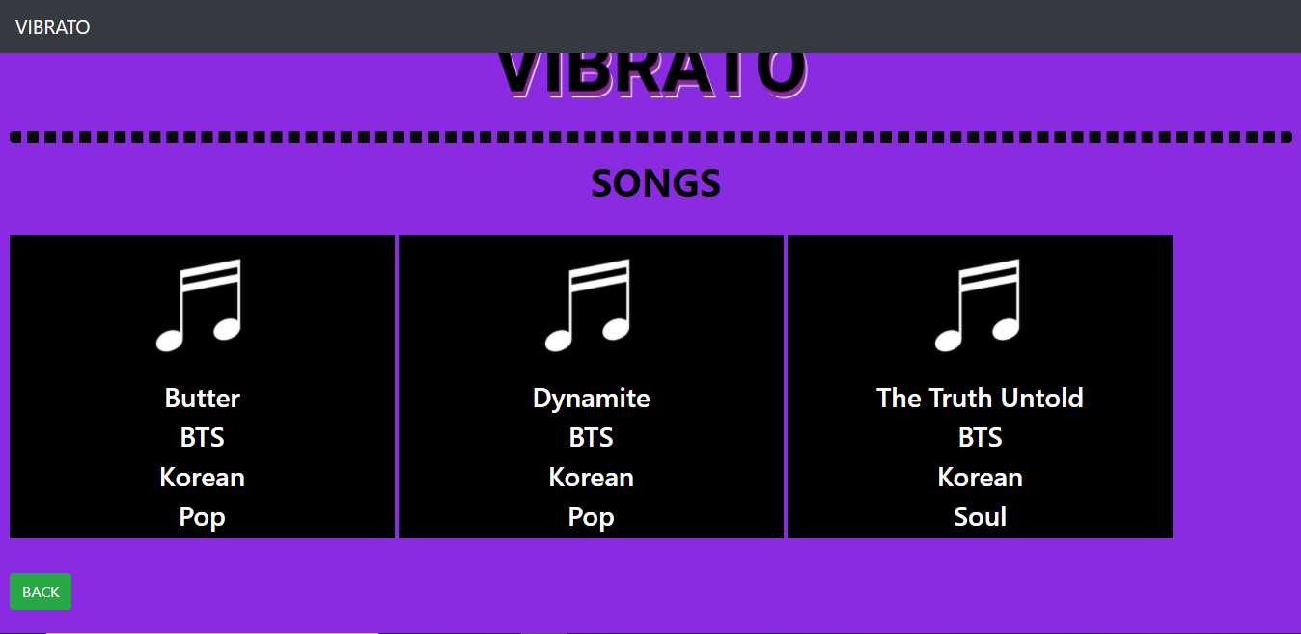
PAGE INSIDE ARTIST, VIEW BUTTON:

Slide 33
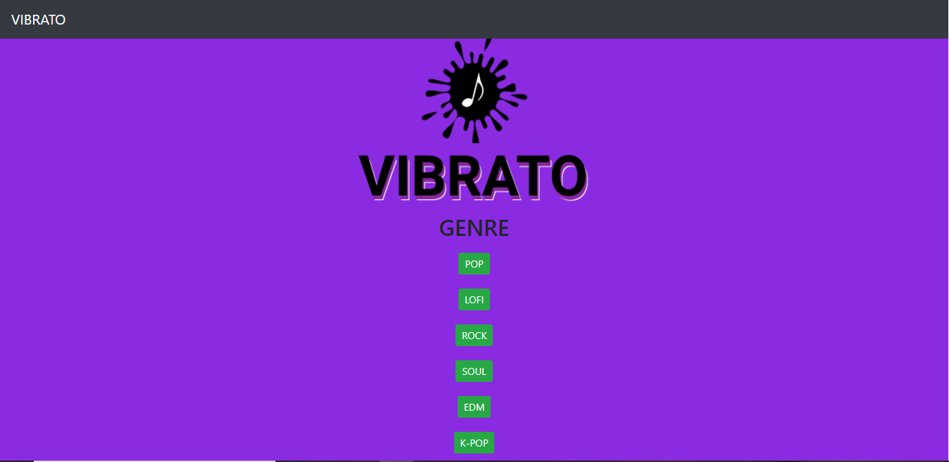
GENRE PAGE

Slide 34
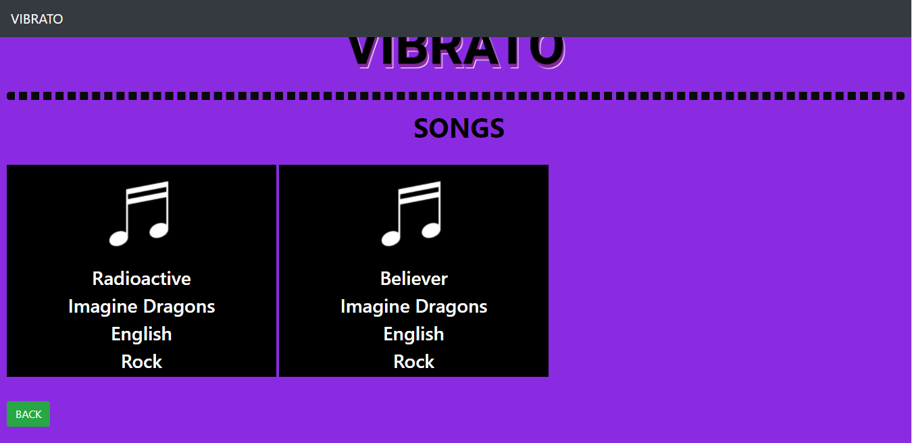
INSIDE GENRE BUTTONS (ANY BUTTON CLICKED)

Slide 35
CONCLUSION
Concluding the project, the concept of SQL, PHP and front end – HTML, CSS was applied to build the website. Furthermore, in future we will try to add audio interface and feature to add songs in a playlist can also be implemented.
MOBILE NUMBER
BILIOGRAPHY
https://www.udemy.com/
http://www.stackoverflow.com
http://www.geeksforgeeks.com

Slide 36
THANK YOU

